Slide 1


Slide 2
Project Overview
Design the micro-scale, mobile and automatically rendering plant
Use Solidwork to draw the design
Conduct economic analysis

Slide 3
Manufacturer Communications
The focus after Audit 2 was to begin sourcing the equipment dimensions from manufacturers in China.
The goal of this process was not only to fill the design specifications document, but also to begin the feasibility analysis process.
Encountering the company Sensitar, they provided not only many of the design specifications needed, but also provided resources of their own rendering techniques.
The constant dialogue between us and them also allowed for continuous development of the final design, allowing us to iterate frequently.

Slide 4
CAD Design
SketchUp
SOLIDWORKS
Rendering

Slide 5
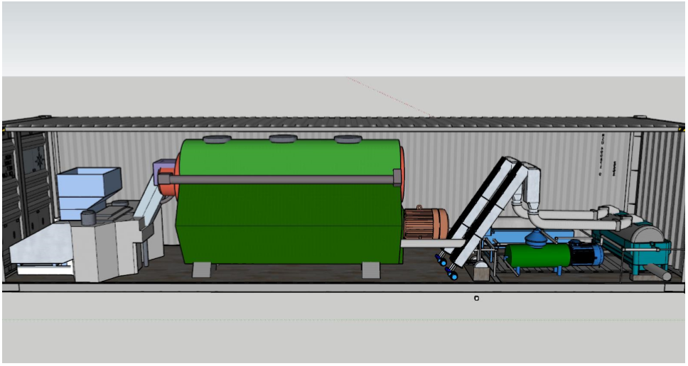

Slide 6
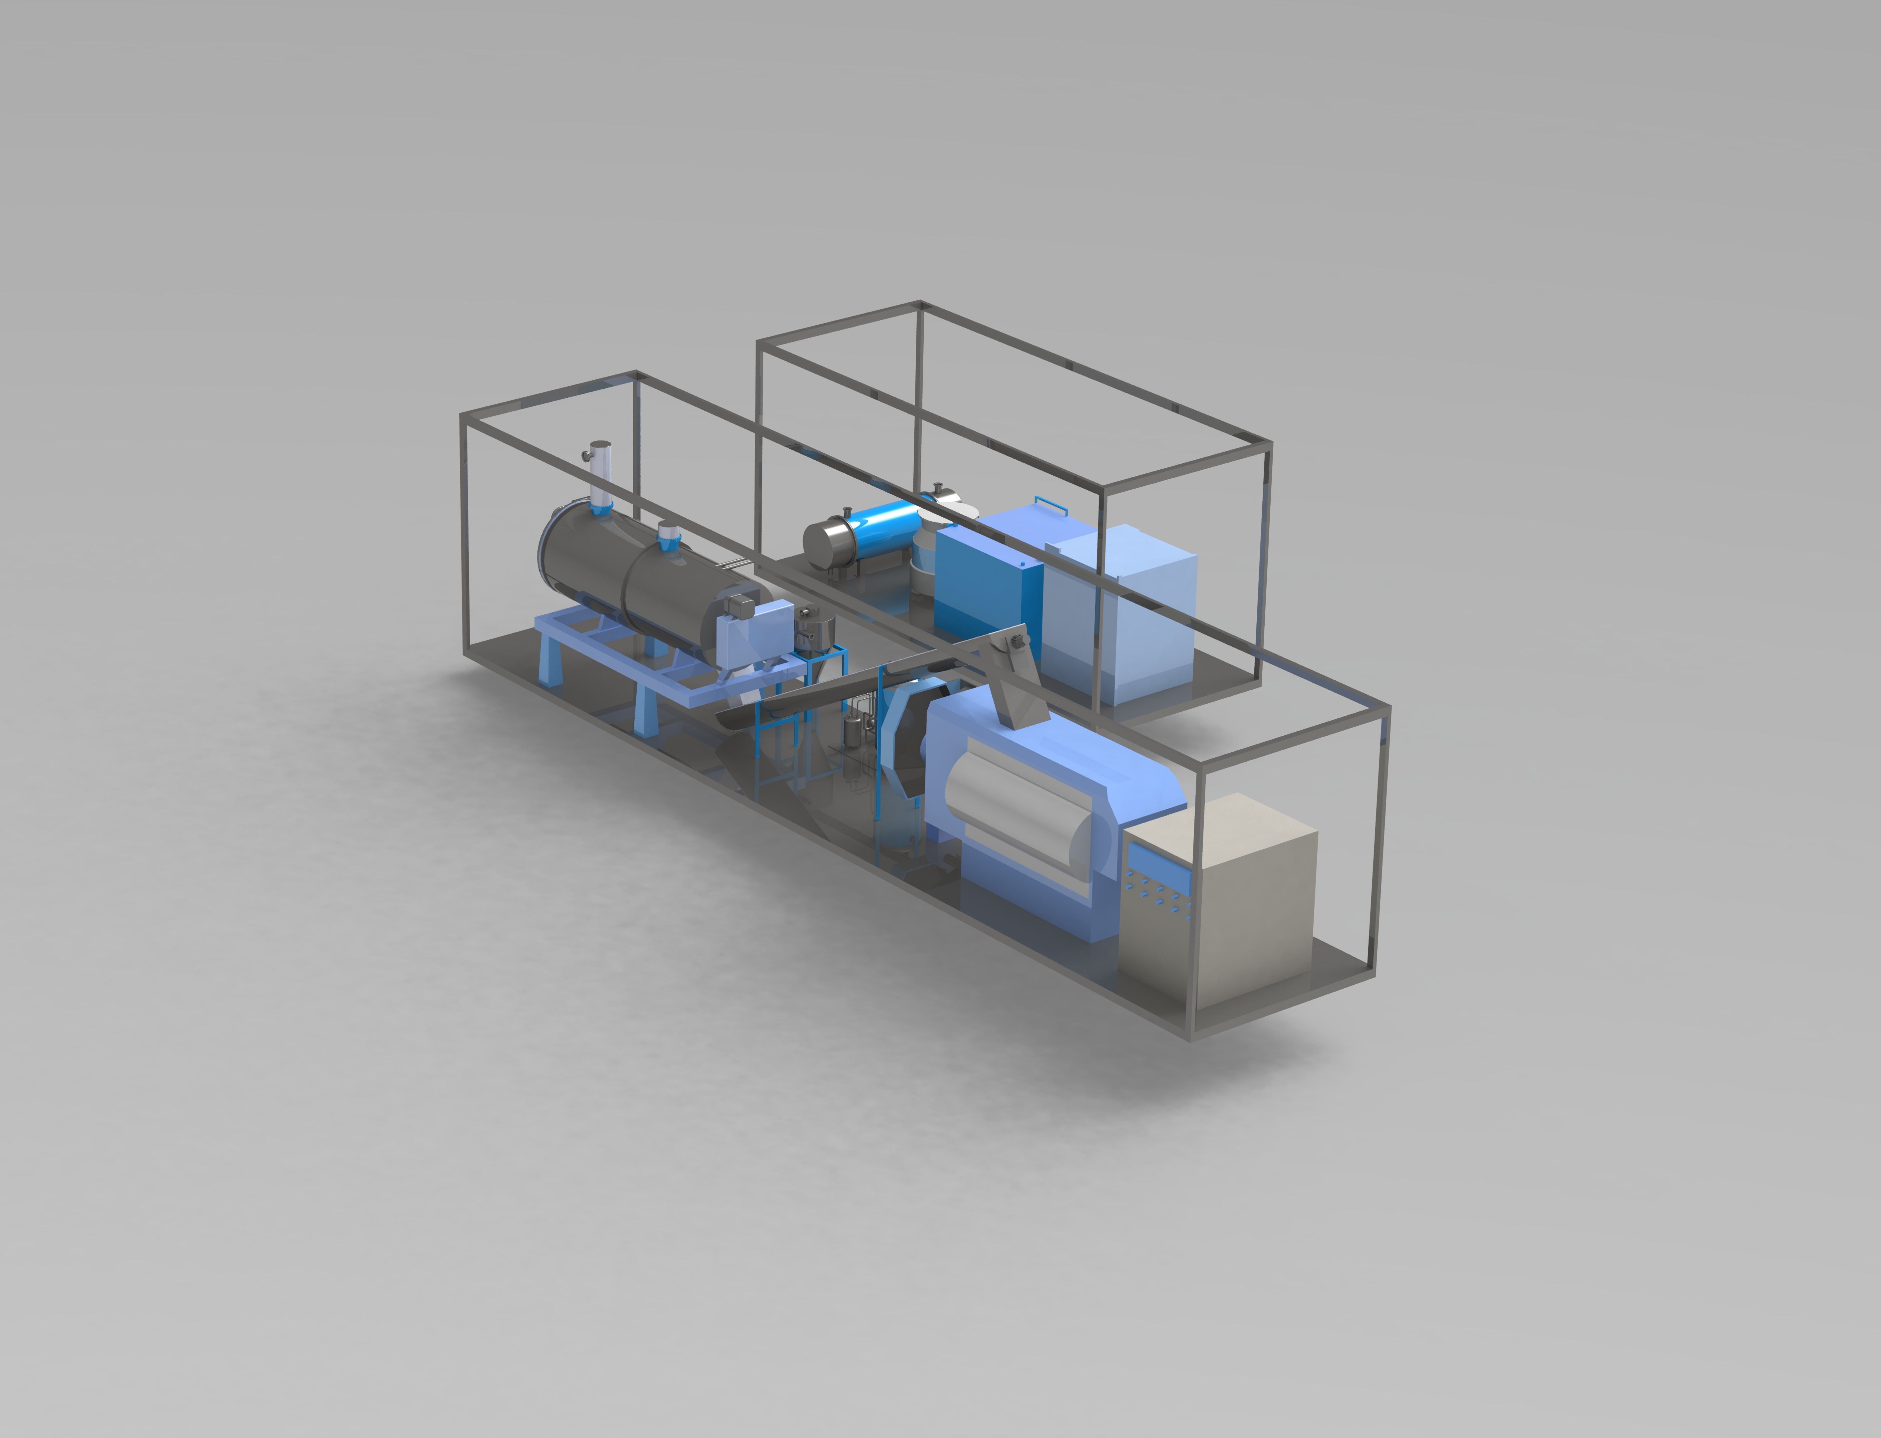

Slide 7
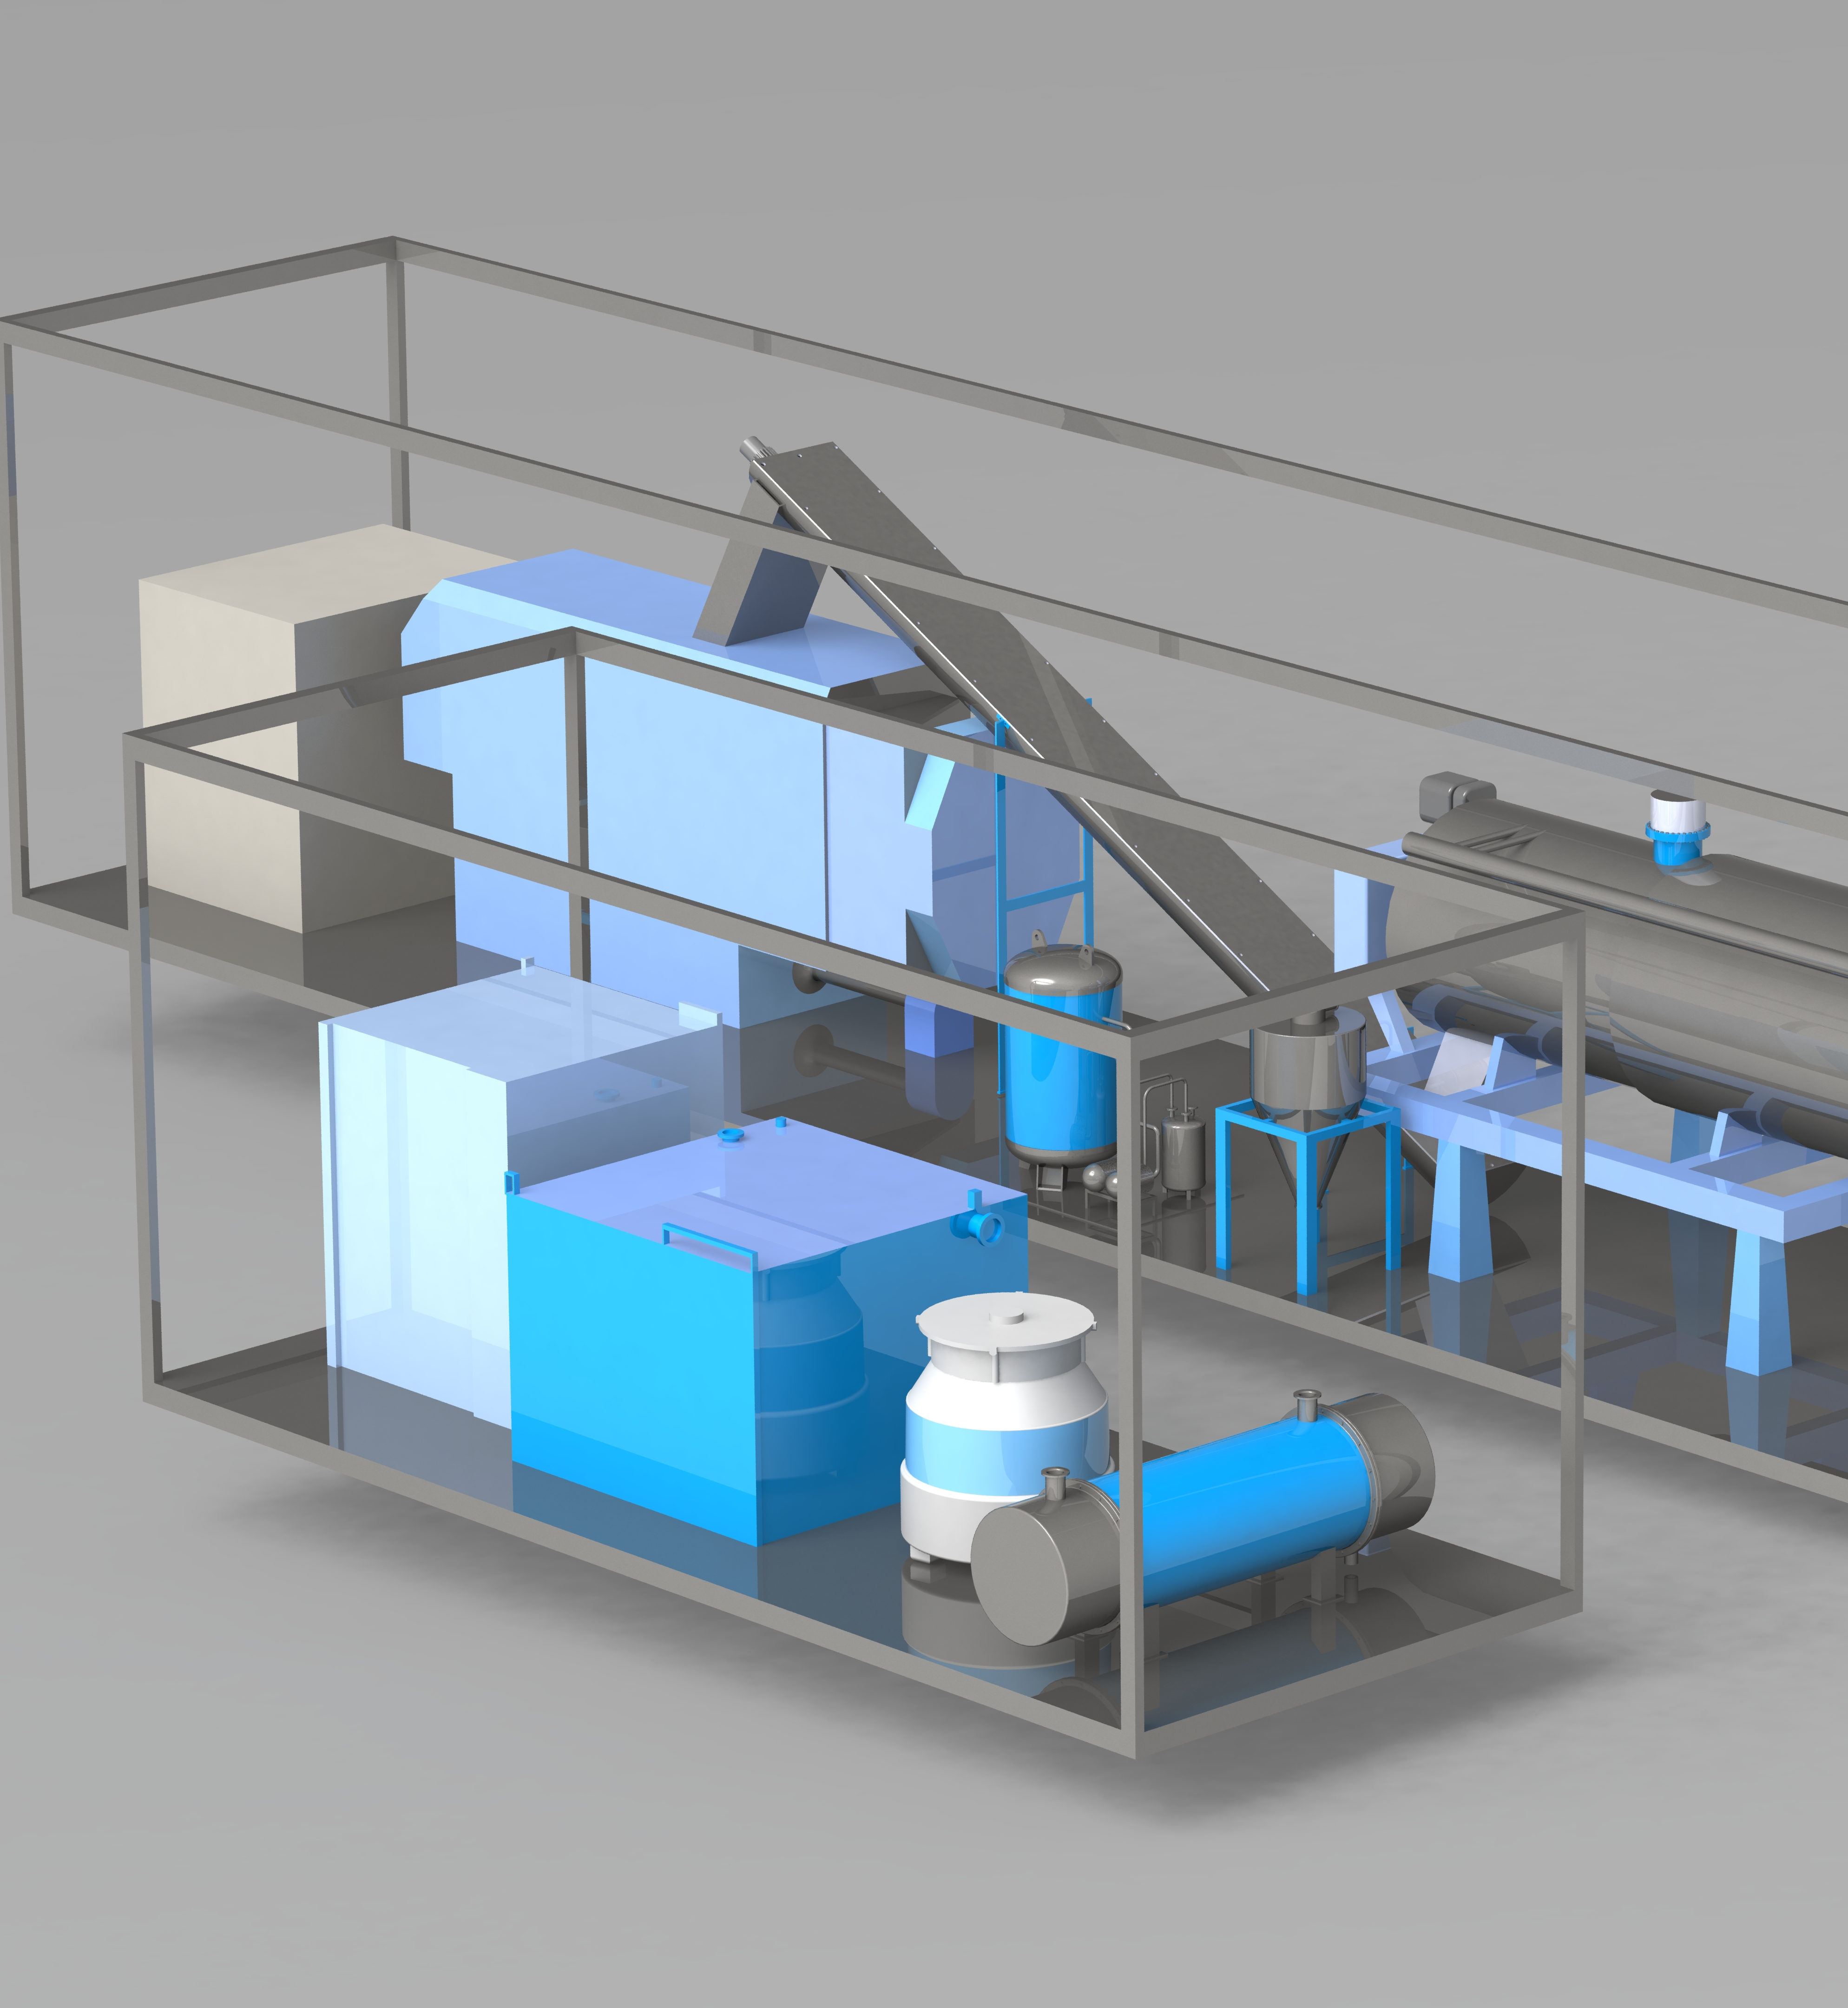
Final 3D Design
This was the last major iteration of the original design presented in Audit 2.
The biggest changes with regards to the Audit 2:
Removal of the Material Breaker, Percolator, Decanter and Seperator
Addition of the cooling system found in the smaller 20 ft crate.
After consultation with manufacturers, it became evident that depending on the quality of final product output desired, some components could be removed.
We also realized that our assumed cooling methods were not sufficient, and would require the inclusion of a second crate, specifically to perform the cooling of the system.

Slide 8
Expert Communications: Proof of Concept
Since our prototyping was done purely with CAD designs, establishing proof of concept was done through industry expert advice.
After completing the preliminary design, it was shown to Goterra and their respective engineers, who provided very positive feedback with regards to our process, feasibility and progress of the design.
ANU Workshop was also consulted with regards to the general structure and material risks outlined in the Conops Document. Feedback was positive, with several areas outlined for potential improvement, mainly towards where cooling systems will be placed, and excess heat extracted.
We also received feedback on the preliminary design from Keith Engineering in Canberra. Feedback from them was mixed, mostly due to clashing techniques regarding the rendering process. Talks are still ongoing, but no major issues have been outlined in the discussions so far.

Slide 9
Needs | Design specification | Unit | Target value | Design achieved | Reference
 | No. of Container |  | 1 | 2 | ISO standard
The whole system is mobile | Size of Containers | ft | 40 | One is 40 and the other is 20
 | Component size | mm | Desired to be fit into 2 containers | As in brochure | -Alibaba manufacturers Sensitar, Aokang ... -RenderTech -Keith Tech -Haarsley
Capacity to process insects | Power requried by each component | kW | N/A | In repository
Throughput efficiency | Throughput | tons/Day | 8 | 8
Affordable cost | Purchasing, installation cost | AUD | Low cost (didn't give specifc value) | 153926.07
 | Runtime cost | AUD/every 8 hrs | Low cost (didn't give specifc value) | 194.32 | Australian Fair Work
 | Lifetime | year | Lifetime (didn't give specifc value) | 8
Safety | Pressure (cooker, vacuum pumpsm, dust colletor) | MPa | Different between different components | In repository | - Austrlian Standards AS 5008:2007
 | Temperture cooker | degree | N/A | 120-140 | Same as above
 | Container load | tons | 26.46 | 13 | ISO standard

Slide 10
Example of component design specification
Batch cooker
Technical parameters ​ | Achievable practical value ​
Throughput ​ | 250kg/hour​
Length ​ | 4000mm​
Width ​ | 1600mm​
Height ​ | 1900mm​
Heating surface ​ | 7m^2​
Max pressure ​ | 1MPa​
Working pressure cooker ​ | 0.6MPa​
Material ​ | Steel​
Power ​ | 5.5KW​
Required temperature ​ | 120-140 degree​

Slide 11
Preliminary Budget
Construction Costs: |  |  | Running Costs (every 8 hours):
Equipment unit | ($) |  | Variable Cost | ($)
40 Foot HQ Container | 13000 |  | Labour Costs | 126
20 Foot HQ Container | 9000 |  | Power Consumption | 48.32
Labour Costs (1-month build) | 5951.07 |  | Other Variable Costs | 20
Continuous Cooker | 32300 |  | Total | 194.32
Screw Conveyer | 7000
Fat Press | 15300
Vacuum Pump | 13000
Dust Collector | 5000
Electricity Unit | 35000
Controller Unit | 7000
Condenser | 11000
Cooling Tower | ~290
Water Tank | 375
Total | 153926.07

Slide 12
Expected Grade
Project Output: Acceptable-Exemplary
ACC: Outputs endorsed by client, design validated against requirement, presentation back to the client organization
EXM: System Level Solutions, iterated prototypes, work validated by experts, evolved solutions.
Decision Making: Acceptable
BAS: Recording decisions, maintaining a decision-log, coherent and accurate meeting minutes, transparent communications, centralized communication, document revisions
ACC: Broad stakeholder engagement, systematic version control, pro-active engagement with externals
EXM: Inclusive decision-making processes
Teamwork: Exemplary-Acceptable
ACC: Engagement with mentors, embracing diverse skill-sets, embracing lessons from failure, reducing uncertainty
EXM: Evolutionary roles, engagement with experts from specialist ﬁelds, transcending disciplinary boundaries, supporting to develop new skills with other team members

Slide 13
Expected Grade
Communication: Exemplary-Acceptable
Systematic processes, professional communication, active listening
Building a shared vision, trust between all stakeholders, communicating and listening with outside audiences, empowering members to engage with new audiences
Reflection: Exemplary-Acceptable
Constructing processes to gain external validation, additional review processes including external stakeholders, helping other teams to reflect and improve
Design Visualization: Exemplary
Physical and virtual representation, enables further opportunities and understanding, acts on opportunities for new audiences
Notes:
1.
building a shared vision not only within the team but also between team and client
, trust between all stakeholders, everyone well informed
communicating and listening with outside audiences,
empowering members to engage with new audiences
2.
constructing processes to gain external validation,
additional review processes including external stakeholders,
helping other teams to reflect and improve as a shadow team
3.
3D printing and 3D CAD
Handover document details where the next stage of the project is
Teach launcher to present

Slide 14
Expected Grade
Expected Grade Range: 70-80

